Slide 1
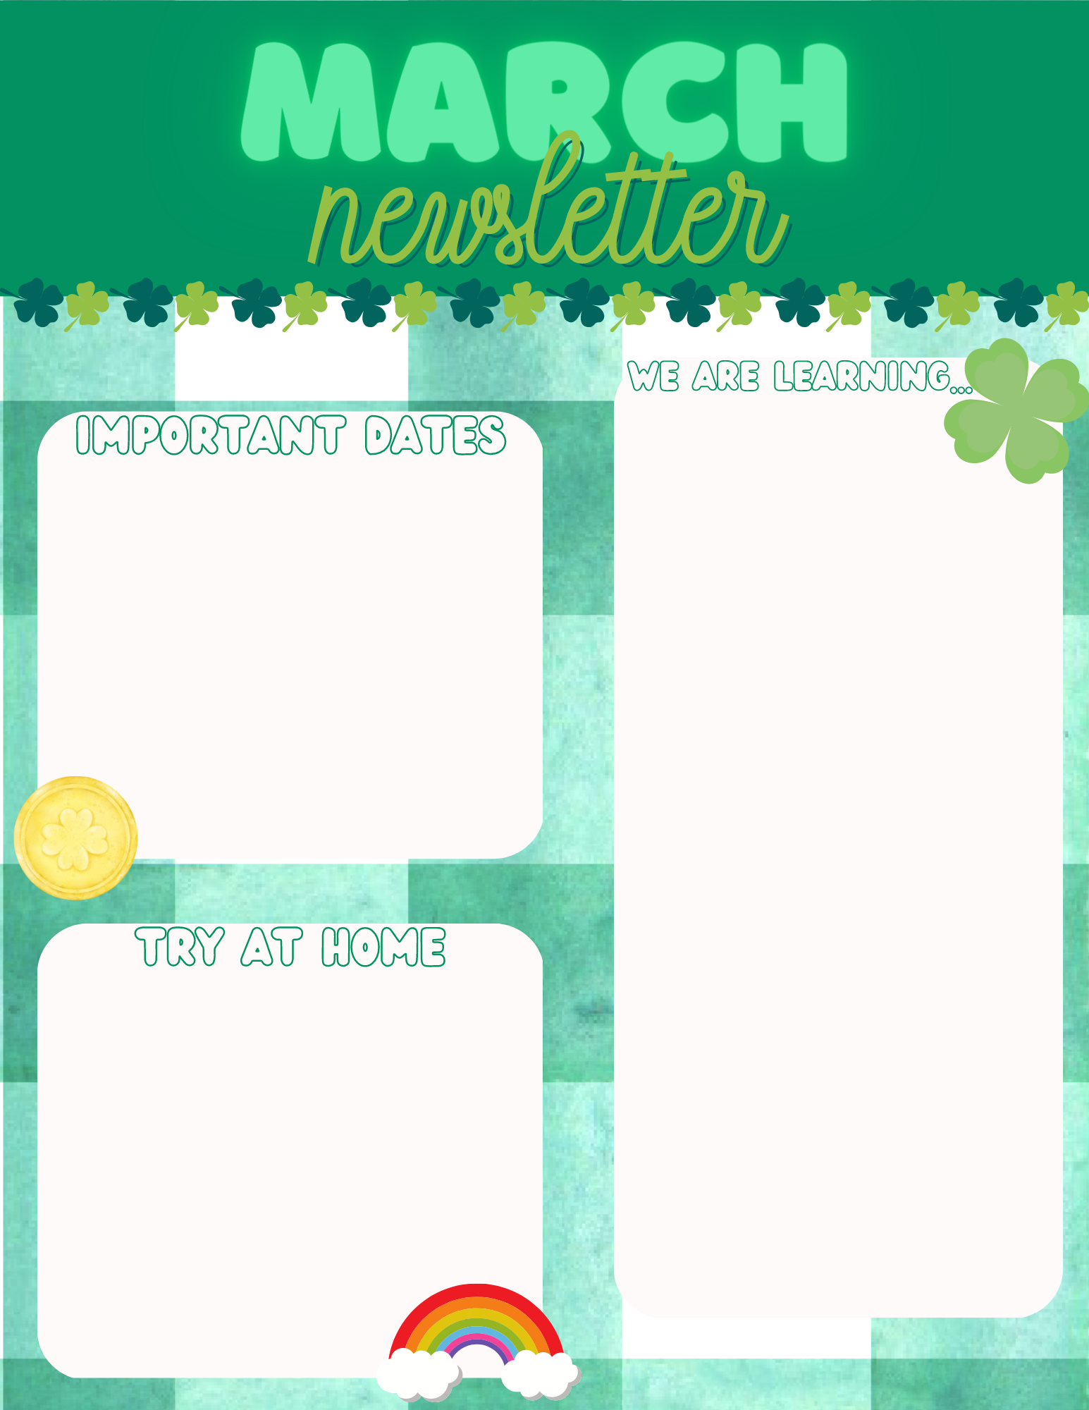
1st Grade Math: Students are working on demonstrating the ability to identify different ways to makes 10.
1st Reading: Students are working on demonstrating the ability to use phonograms and write in complete sentence.
2nd Grade Math: Students are working on organizing data.
2nd Reading: Students are working on identifying antonyms and synonyms.
March 6th- Reading Night
March 21st- Early Dismissal 11:15
March 24th- April 1st- Spring Break
1st Grade- Sight Word Practice
2nd Grade: Sight Word Practice

